Slide 1
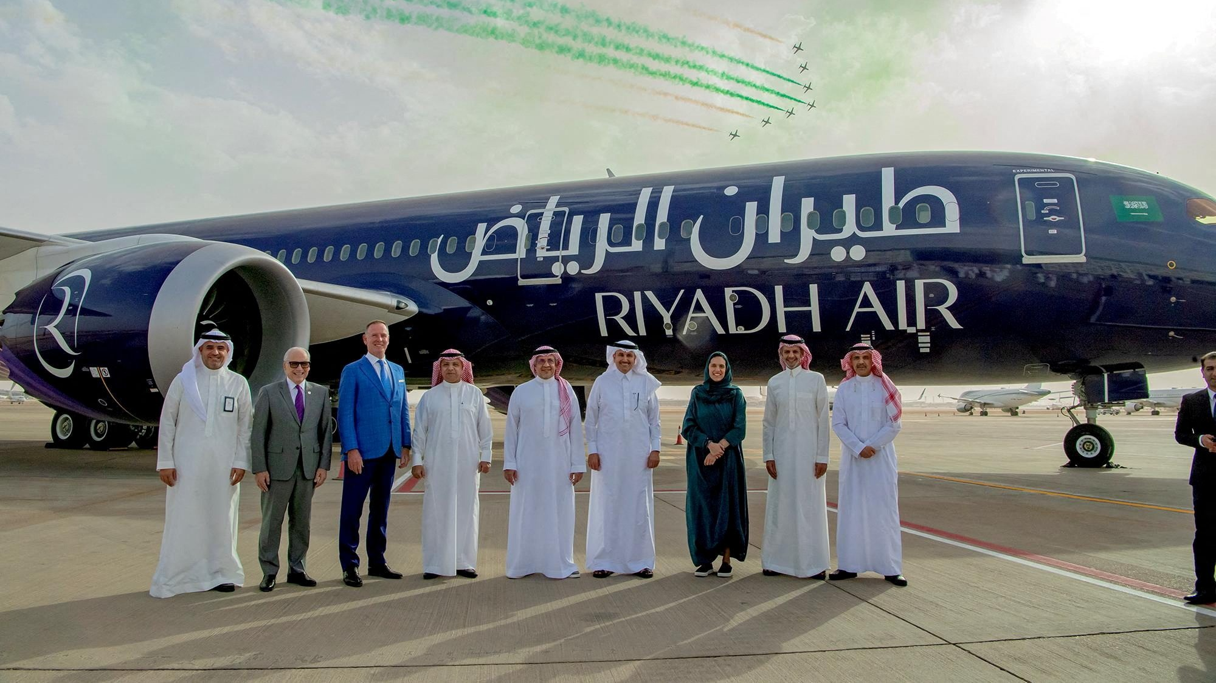
What is
Riyadh Air ?

Slide 2
What is
Riyadh Air ?

Slide 3
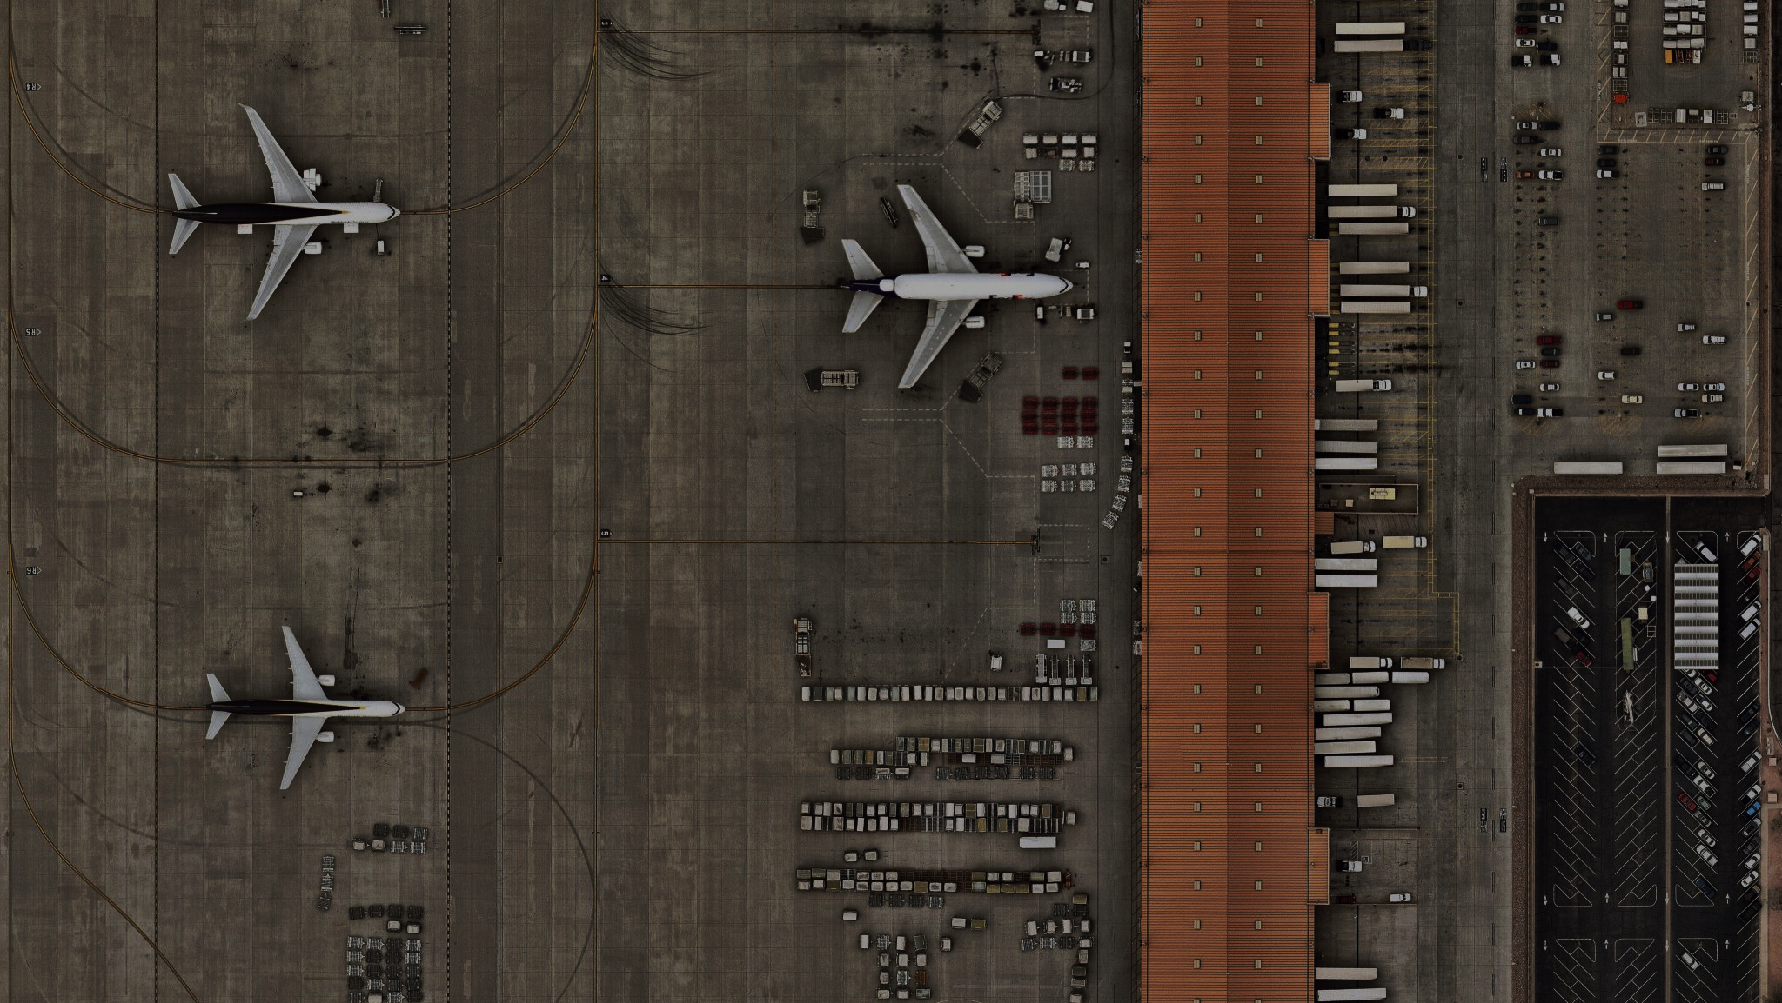
Now,
What Is Riyadh Airlines Booking System ?

Slide 5

What
Needs ?

Slide 6



What is the Problem?
The New Team ?
What is the Proposed Solution?

Slide 7

Problem Definition

Slide 8


Problem Definition
This project aims to address Riyadh Air’ challenges in establishing an advanced online platform. The current digital infrastructure limitations impede critical functions like flight bookings and reservation management, affecting user experience for both customers and administrators.
Proposed Solution

Slide 9
Problem Definition
Proposed Solution
GOALS and Objectives
This project aims to address Riyadh Air’ challenges in establishing an advanced online platform. The current digital infrastructure limitations impede critical functions like flight bookings and reservation management, affecting user experience for both customers and administrators.
The proposed Solution the Riyadh Airlines Booking System is a sophisticated web-based application meticulously crafted to optimize the flight booking process for users, concurrently providing robust management tools for airline personnel. The system encompasses essential features, including a user registration system, advanced flight search and booking functionalities, reservation management capabilities.
1. Intuitive Interface
2. Efficient Booking Process
3. Responsive Design
4. Real-time Flight Updates
5. User Account Management

Slide 10
THE TEAM

Slide 11





THE TEAM
RIYADH ALTHABIT
SULTAN ALQAHTANI
YAZEED ALOSAIMI
SAUD ALAOTIBI
RIYADH ALTHABIT
YAZEED ALOSAIMI
SAUD ALAOTIBI
MOHAMMED ALESHAWI
MOHAMMED ALESHAWI
SULTAN ALQAHTANI

Slide 12
THE TEAM
Project Leader
Leading with expertise, he handles 90% of the coding workload, ensuring on-time, on-budget project delivery. Coordinates teams, defines objectives, and tackles challenges with Stakeholders
MOHAMMED ALESHAWI
RIYADH ALTHABIT
SULTAN ALQAHTANI
YAZEED ALOSAIMI
SAUD ALAOTIBI

Slide 13
THE TEAM
Team Member
Inspiring precision and collaboration in coding and documentation, he leads with a visionary project idea, ensuring on-time, on-budget delivery
MOHAMMED ALESHAWI
SULTAN ALQAHTANI
RIYADH ALTHABIT
YAZEED ALOSAIMI
SAUD ALAOTIBI

Slide 14
THE TEAM
Team Member
Elevating projects through adept coding and polished presentation skills.
MOHAMMED ALESHAWI
SULTAN ALQAHTANI
RIYADH ALTHABIT
YAZEED ALOSAIMI
SAUD ALAOTIBI

Slide 15
THE TEAM
Team Member
Expert in coding, project ideation, and thorough documentation for seamless project success. Transforming concepts into visually appealing and functional front-end solutions.
MOHAMMED ALESHAWI
SULTAN ALQAHTANI
RIYADH ALTHABIT
YAZEED ALOSAIMI
SAUD ALAOTIBI

Slide 16
THE TEAM
Team Member
Crafting compelling presentations with creativity and finesse.
MOHAMMED ALESHAWI
SULTAN ALQAHTANI
RIYADH ALTHABIT
YAZEED ALOSAIMI
SAUD ALAOTIBI

Slide 17
System Scope
KEY FEATURES
USERS AND STAKEHOLDERS
KUIL
LIMITATIONS
INTERACTIONS

Slide 18
KEY FEATURES
Users can easily book flights and make reservations.
Administrators have oversight and control over flight details and reservations.
Additional features include an appealing homepage, user profiles, currency converter, ratings system, and email notifications.
S
USERS AND STAKEHOLDERS
Users: Individuals booking flights.
Administrators: Manage flights, reservations, and system announcements.
W
INTERACTIONS
Users search for and make reservations.
Interact with additional features like currency converter and ratings system.
O
LIMITATIONS
Limited trips for testing purposes.
Fake payment system in the prototype.
Limited administrative features and no integration with the government's national ID card (ABSHR).
T

Slide 19





Loop Of Dev
REQUIREMENT ANALYSIS
REVIEW AND REFINE
DESIGN
CUSTOMER EVALUATION
PROTOTYPING

Slide 20
PROJECT DEVELOPMENT
Timeline
2 Weeks
Testing
Month 3
MILESTONE
Month 2
Design
Month 1
Planning

Slide 21




Software Requirements and Specifications
Functional Requirements
01 Flight Search
02 Booking System
03 User Account Management
04 Admin Dashboard

Slide 22
NONE FUNCTIONAL REQUIREMENTS
USABILITY
The website should be user-friendly, with a focus on simplicity and ease of navigation.
OPTIMIZED USER EXPERIENCE
Ensure optimal performance with quick load times and responsive interactions for a smooth user experience, while maintaining simplicity in design and functionality suitable for the average user's technical proficiency.

Slide 23
Lets Dive into UI AND CODE

Slide 24
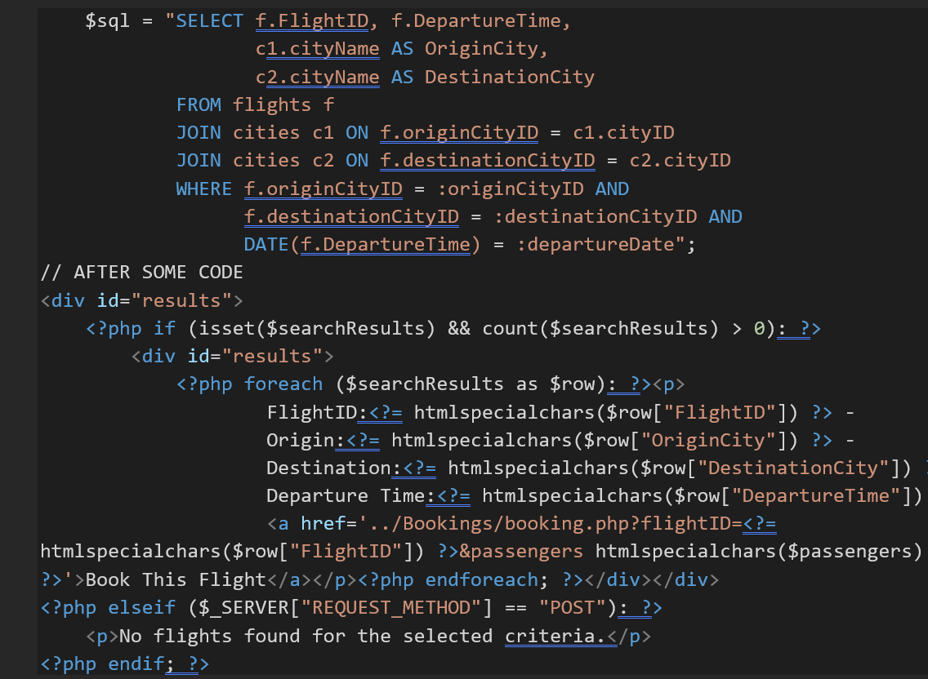
ONE OF THE TROUBLING CODE WE HAVE CREATED
Code for fetching flights

Slide 25
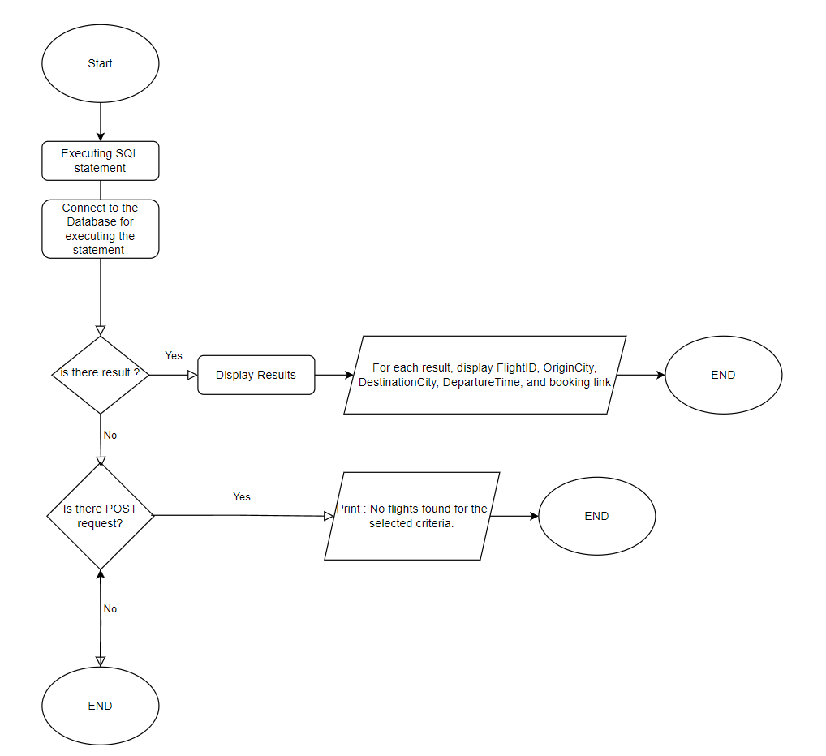
THE CODE EXPLAINED

Slide 26
LET’S SEE the user Interface

Slide 27
Sections in the Home Page
01.
02.
03.
Welcome
About Us and Visions
Services
04.
05.
06.
Travel Toolkit
Dev Team
Facts-Ratings
08.
Admin Announcements and Contact Us

Slide 28
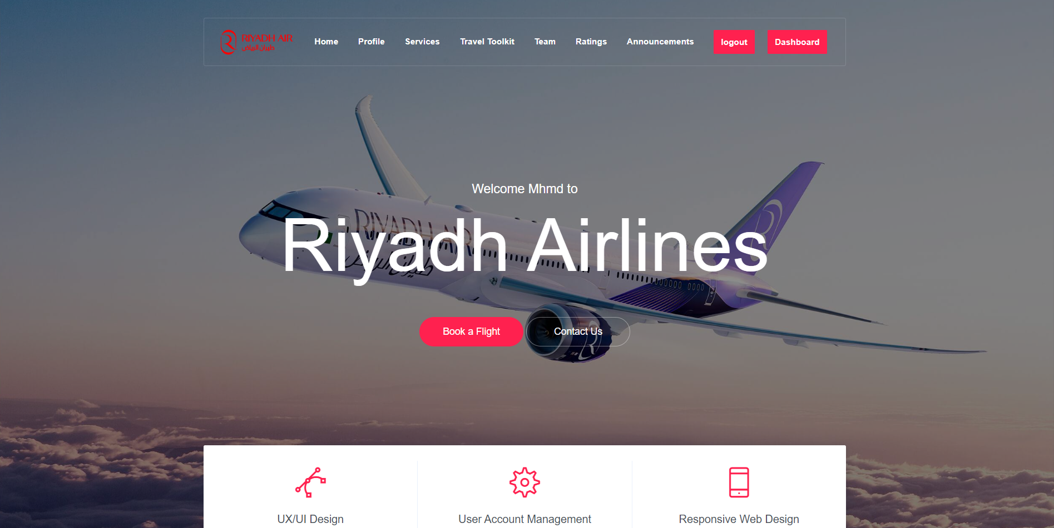
Welcome Section

Slide 29
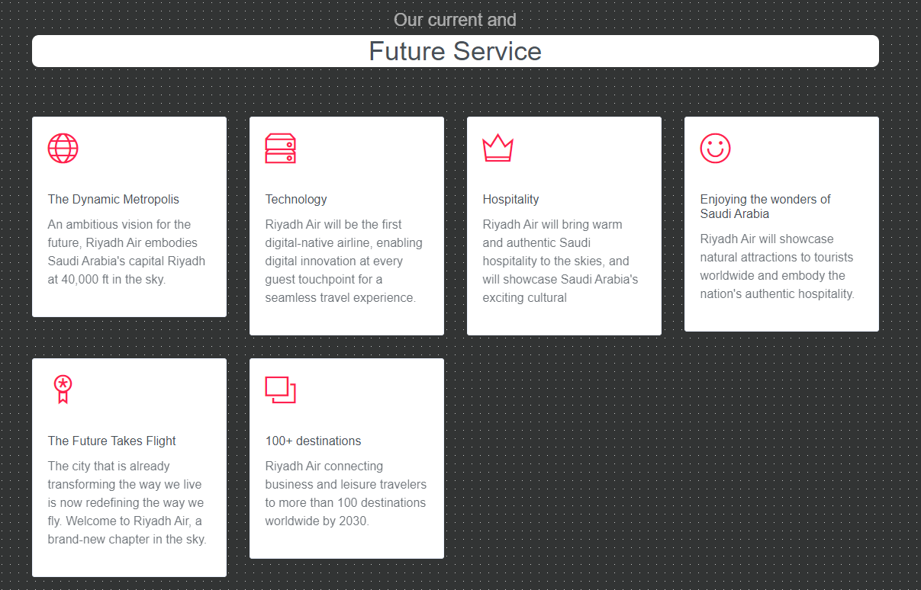
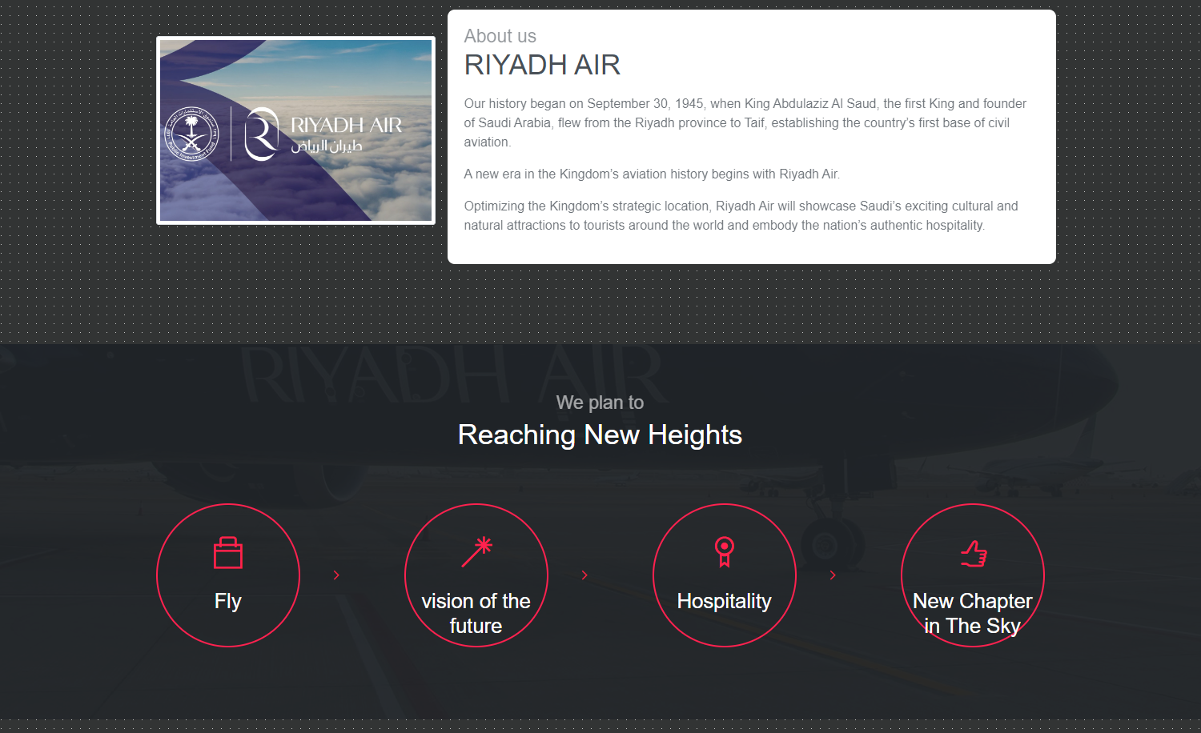
About Us and Visions Section

Slide 30
Services Section
The services section succinctly presents Riyadh Airlines' key offerings, providing clear information to enhance users' understanding of available services.

Slide 31
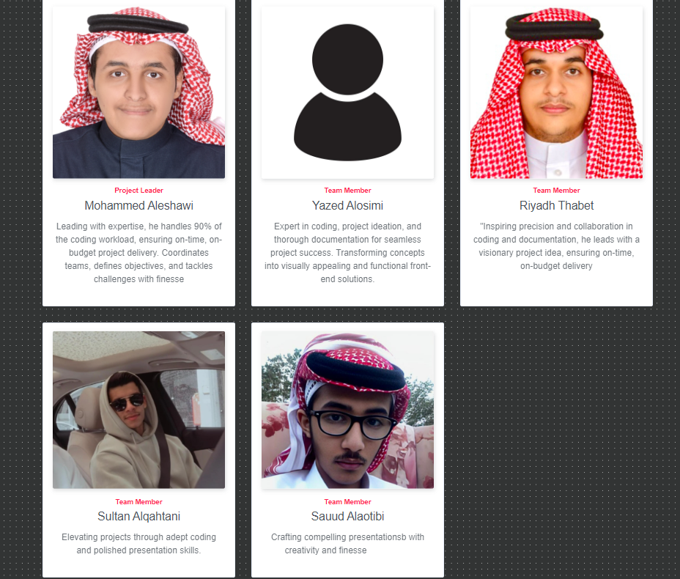
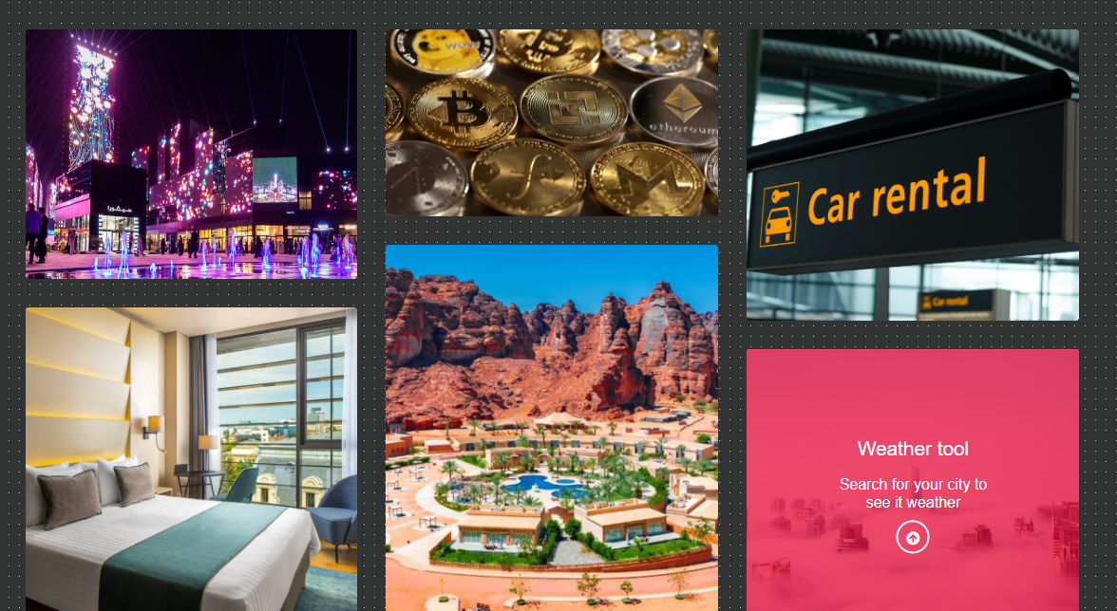
Travel Toolkit Section

Slide 32
Dev Team Section
dedicated area is allocated to introduce the developers' team behind the Riyadh Airlines website. This transparency provides users with insight into the individuals responsible for the site's development, fostering a connection between users and the development team.

Slide 33
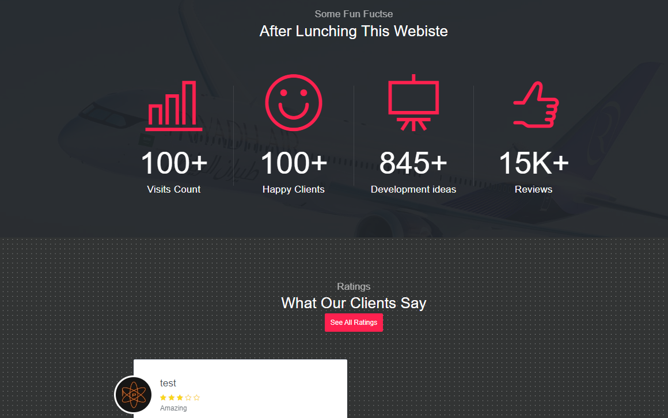
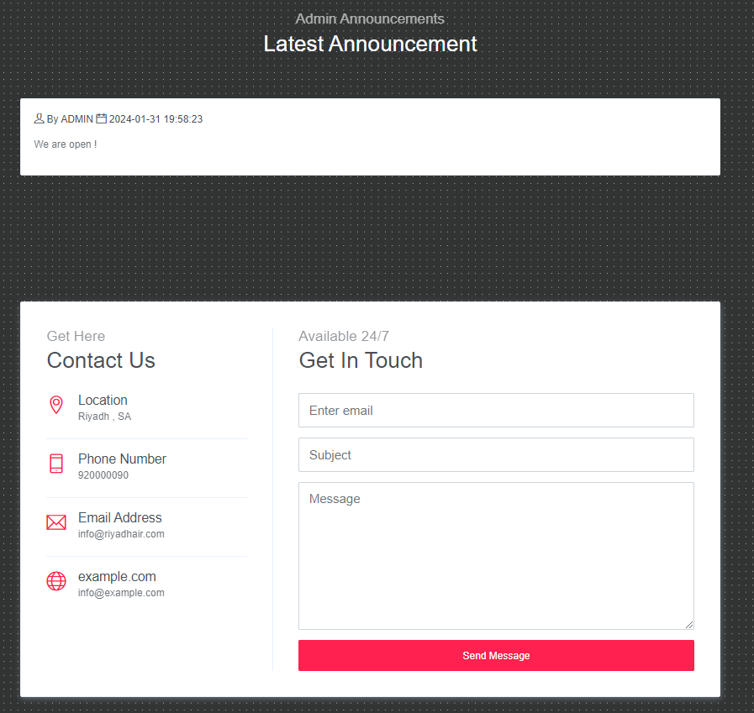
Facts-Ratings Section

Slide 34
Admin Announcements AND Contact Us Section:
The final section features announcements from administrators, ensuring users are informed about any important updates or news. Additionally, users are provided with contact information, facilitating easy communication between users and the administration.

Slide 35

Now Let Us See The Rest Of Our Website Pages

Slide 36
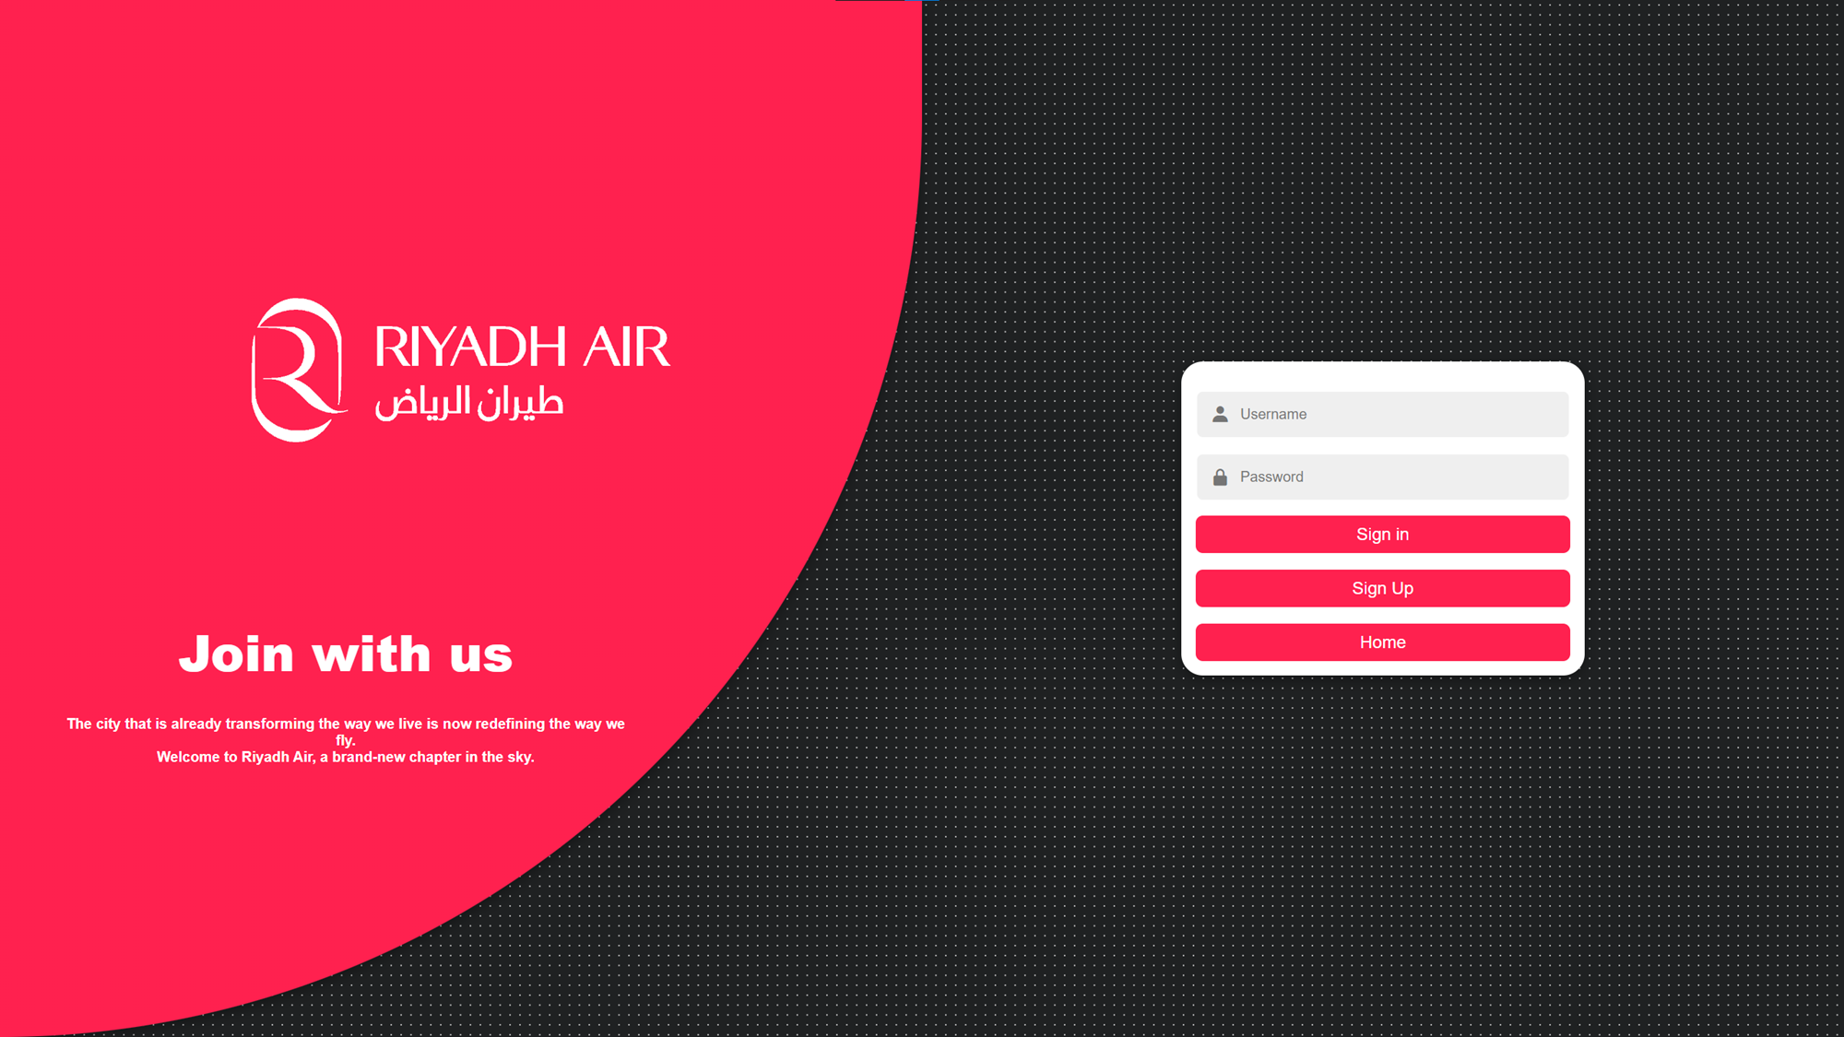

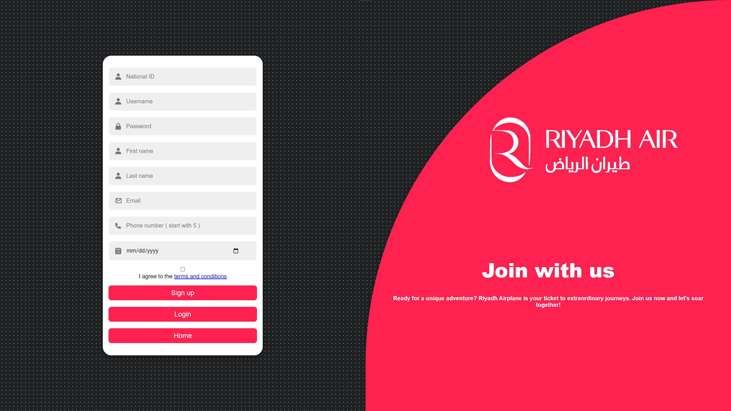
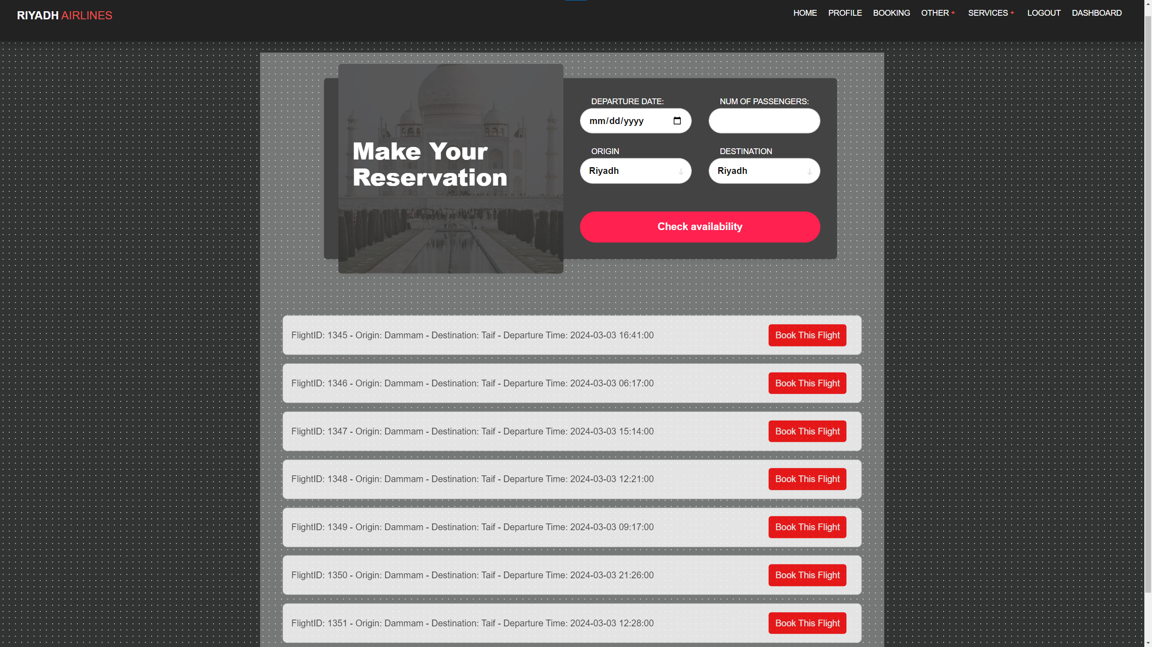
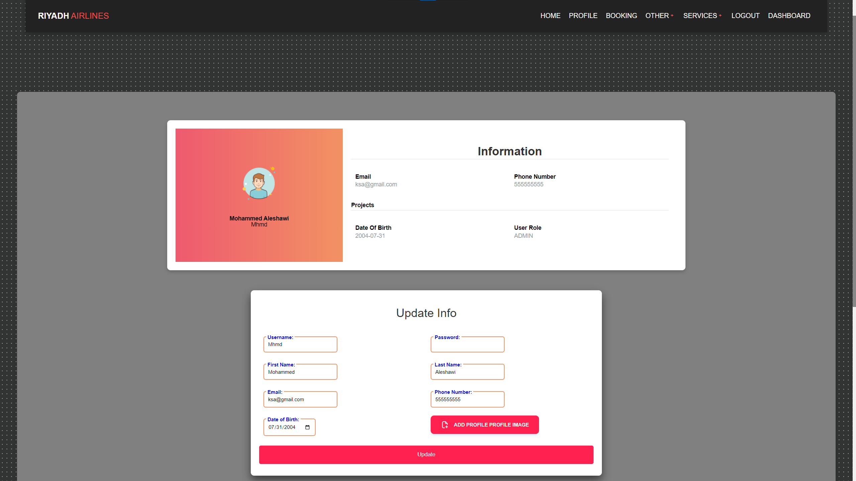
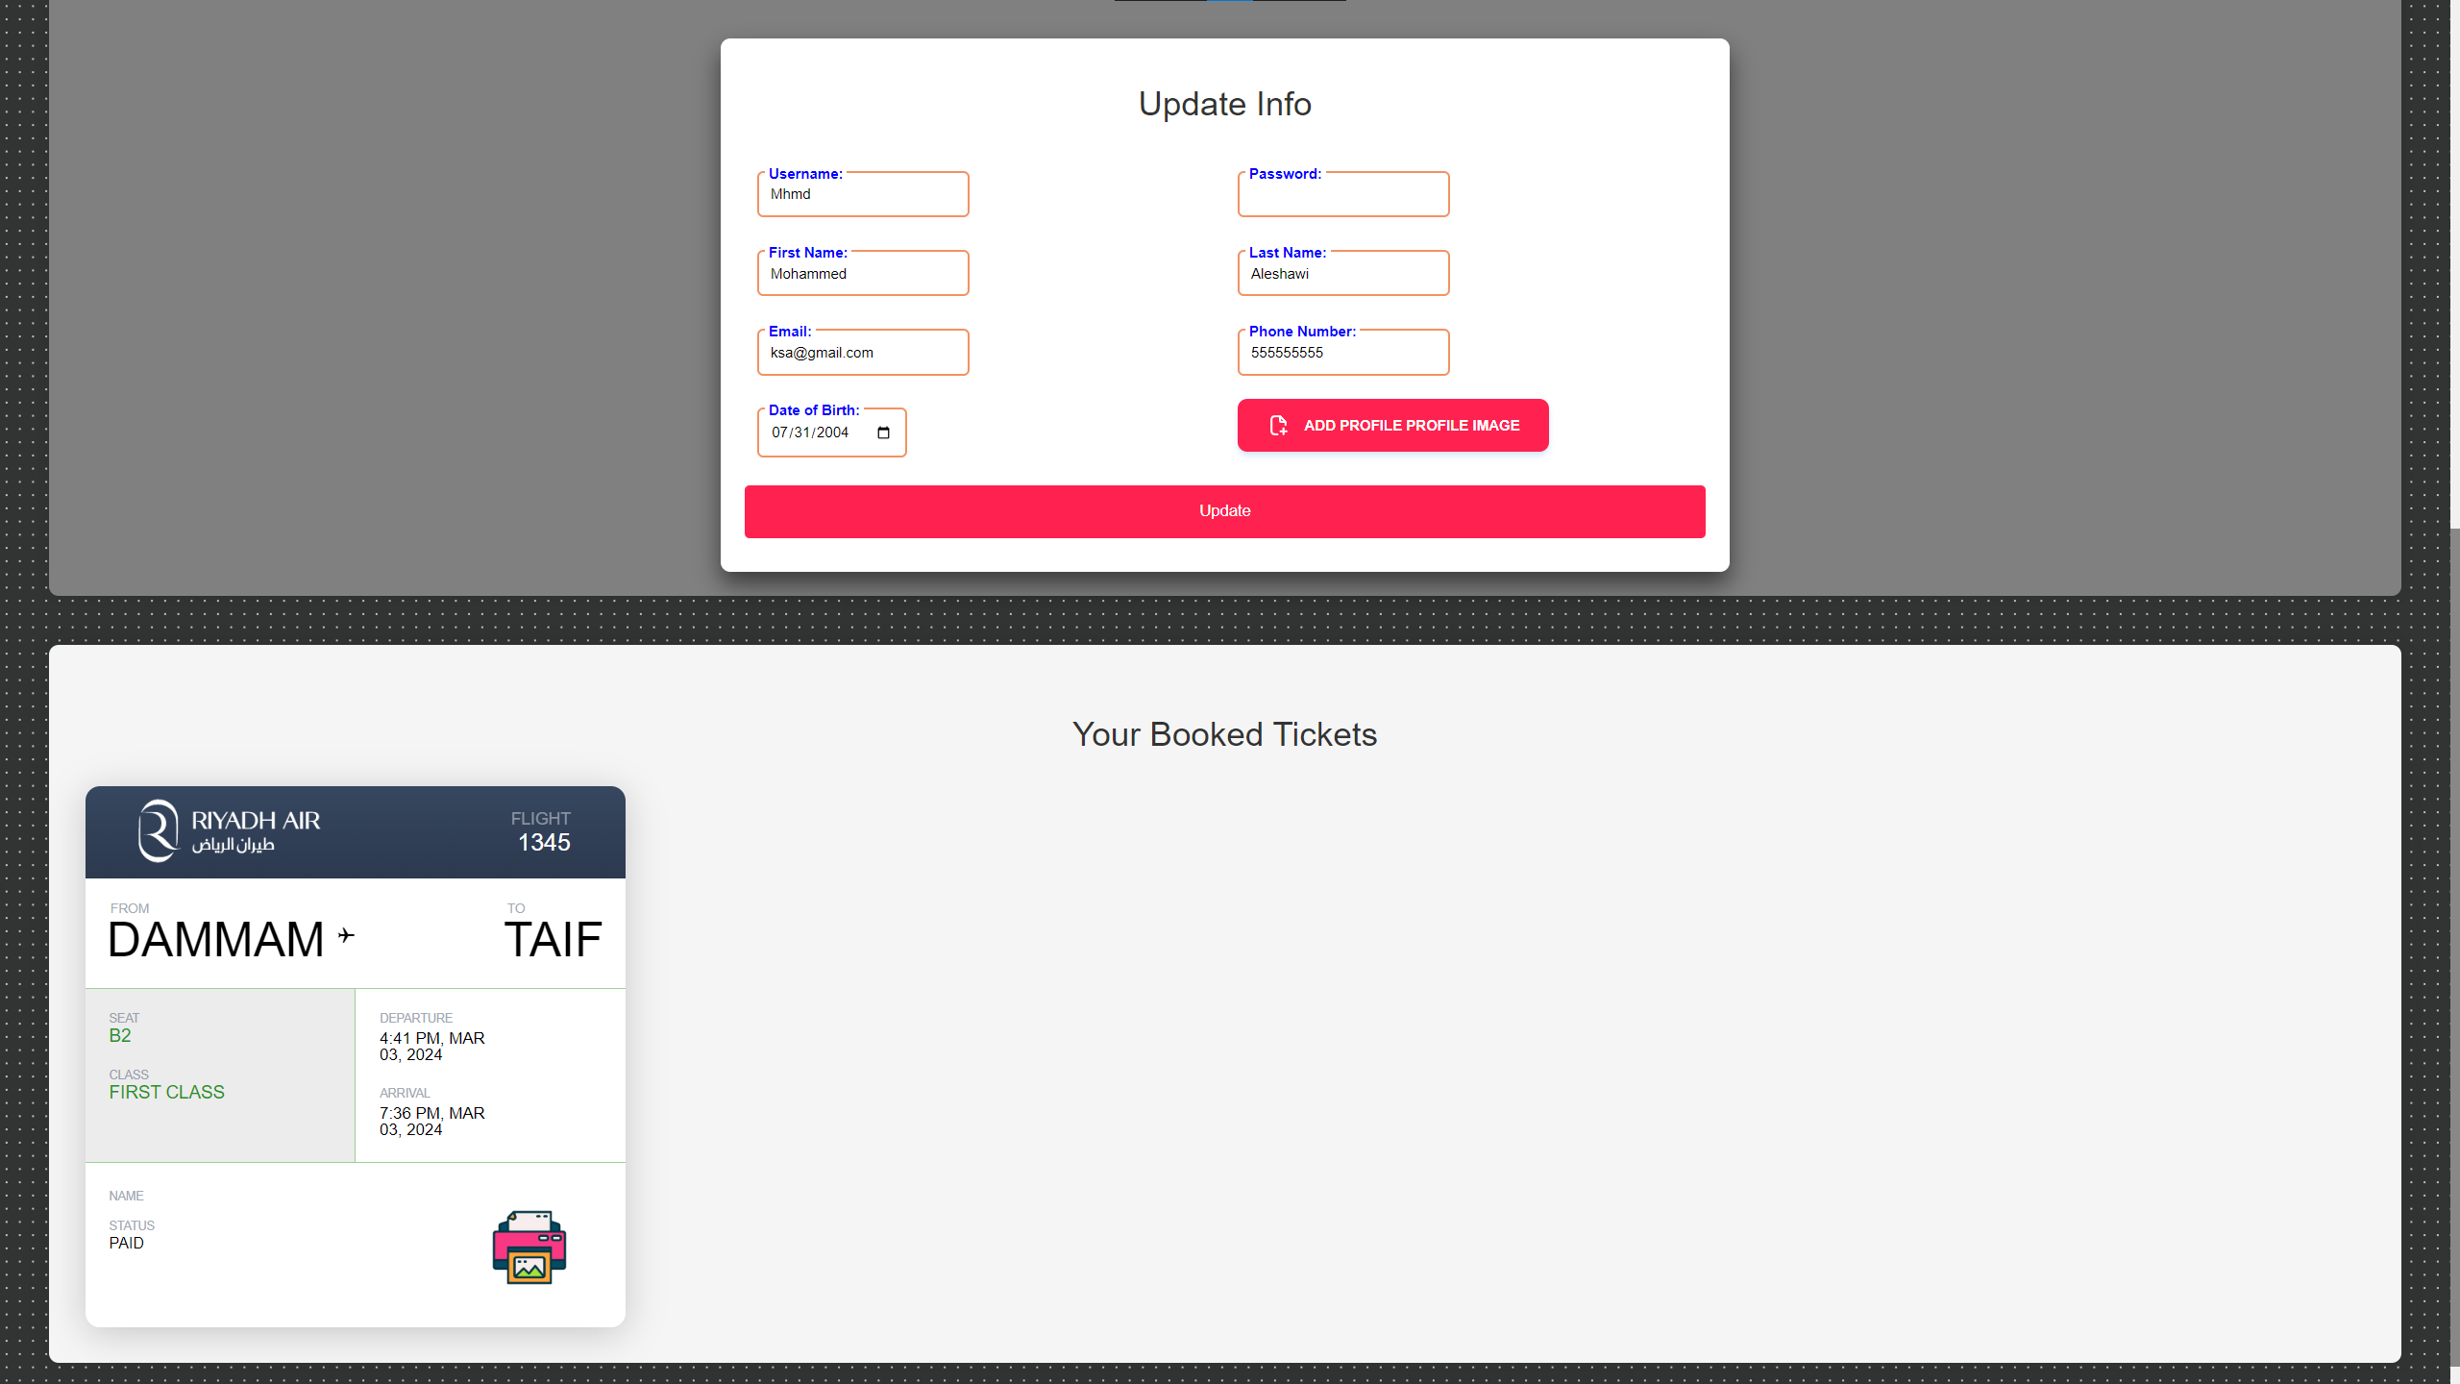
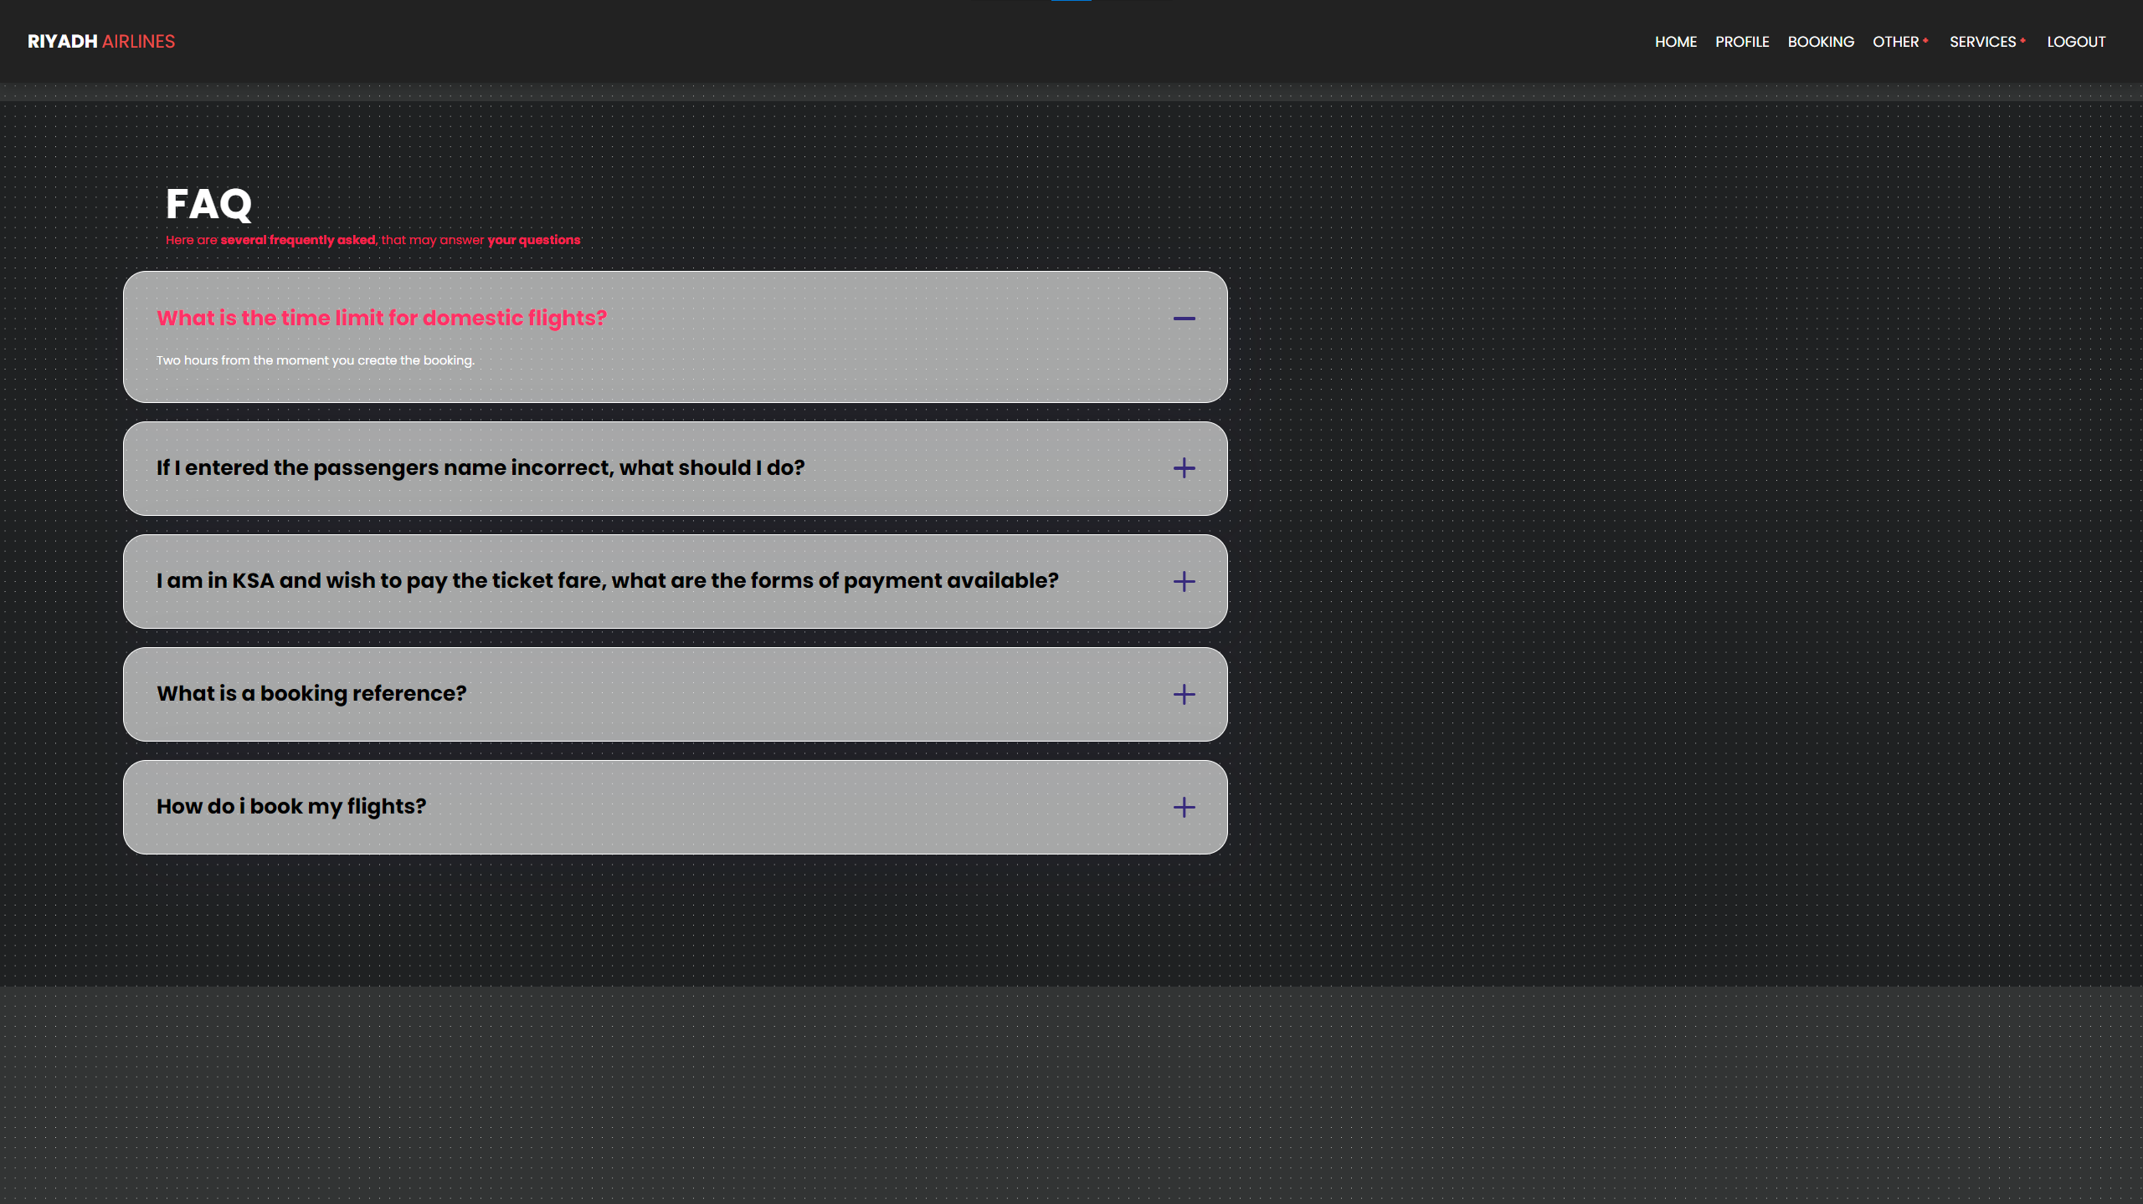
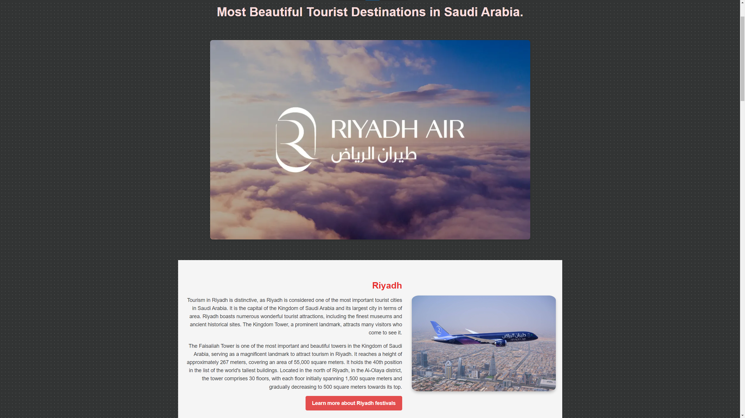
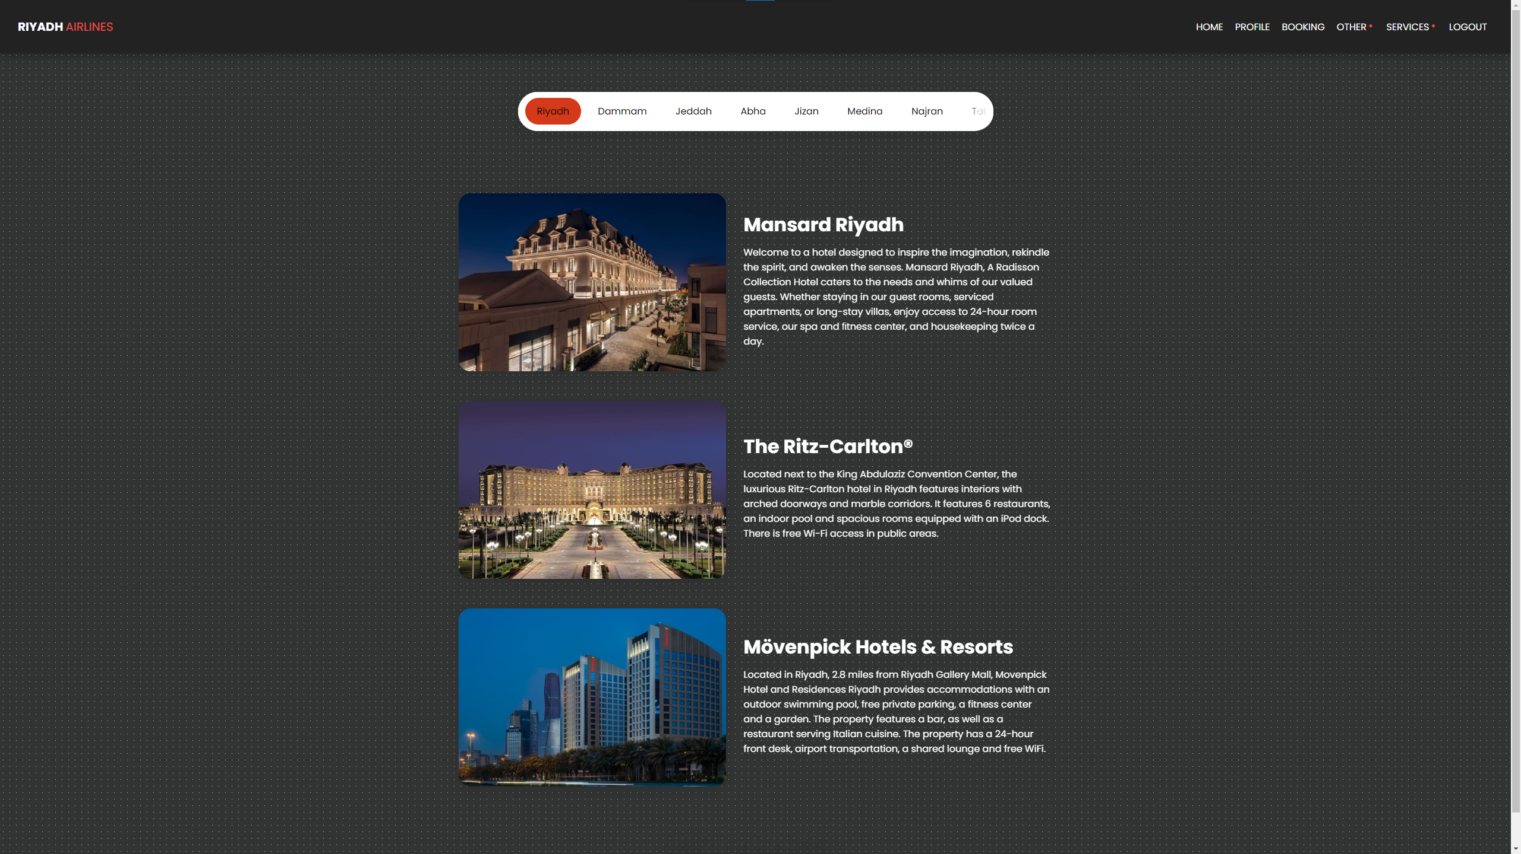

Slide 37


Slide 38


Slide 40


Slide 42


Slide 43

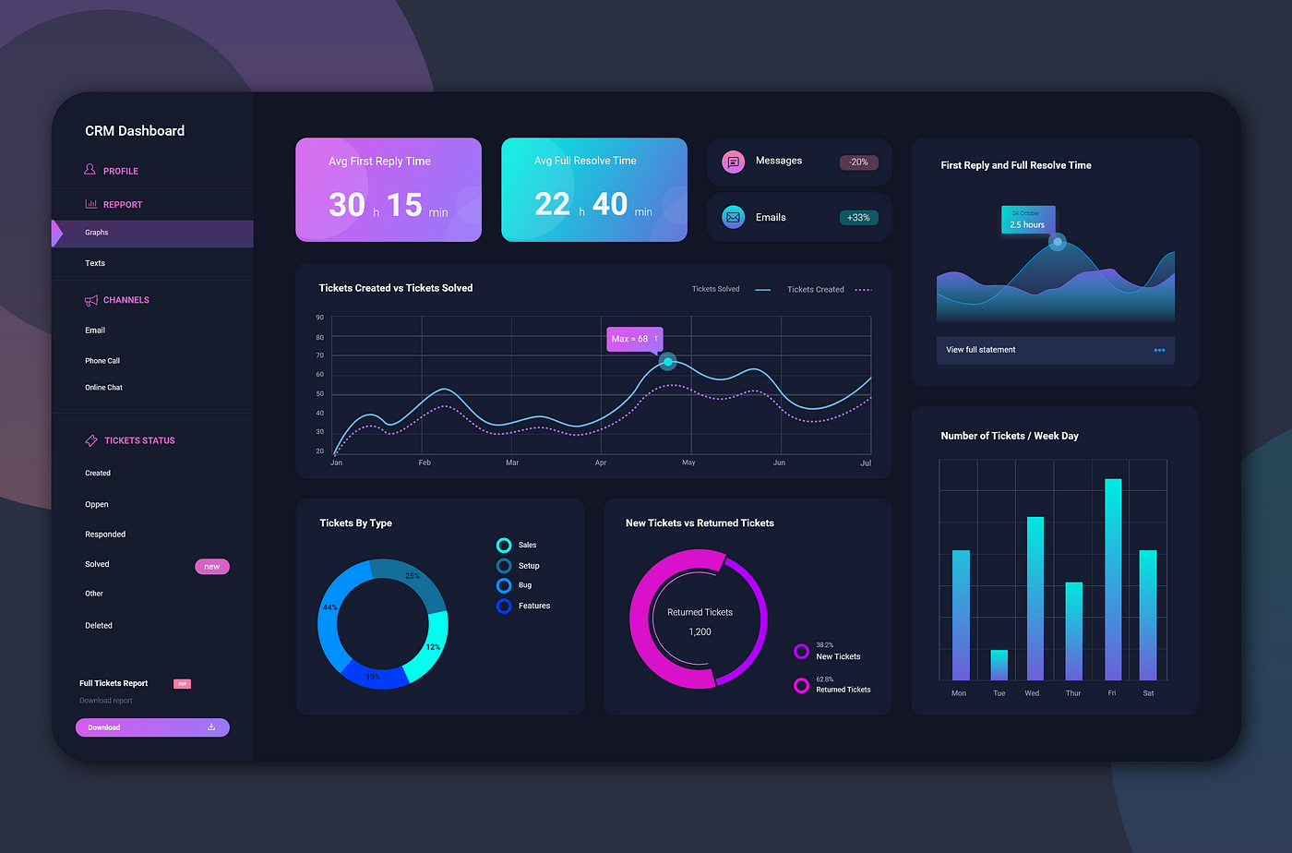
ADMINISTRATION
DASHBOARD
SECTION

Slide 44


UI For The Admin Dashbord Page
Here is where you will see what the adminstrator can see

Slide 45
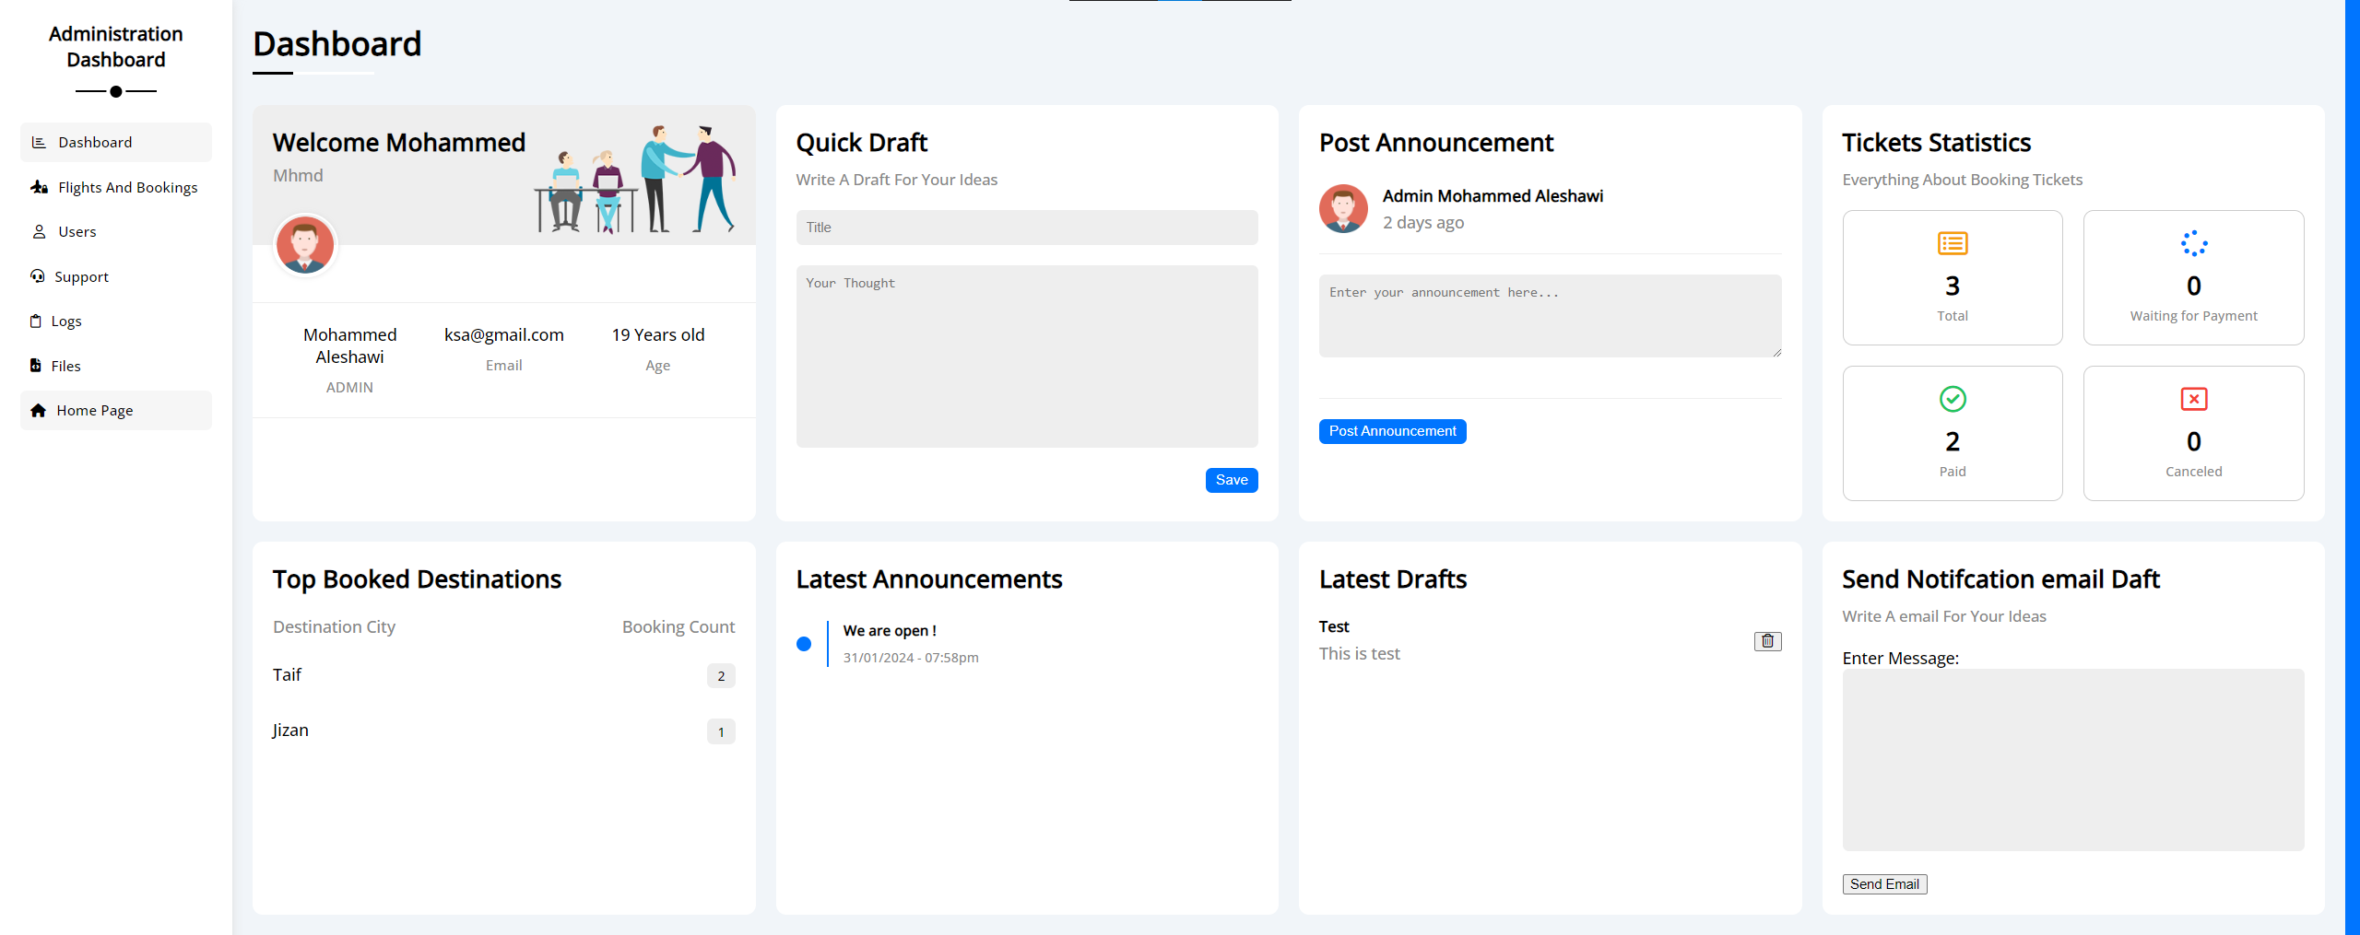
01
Home DB

Slide 46
The Home Section

Slide 47
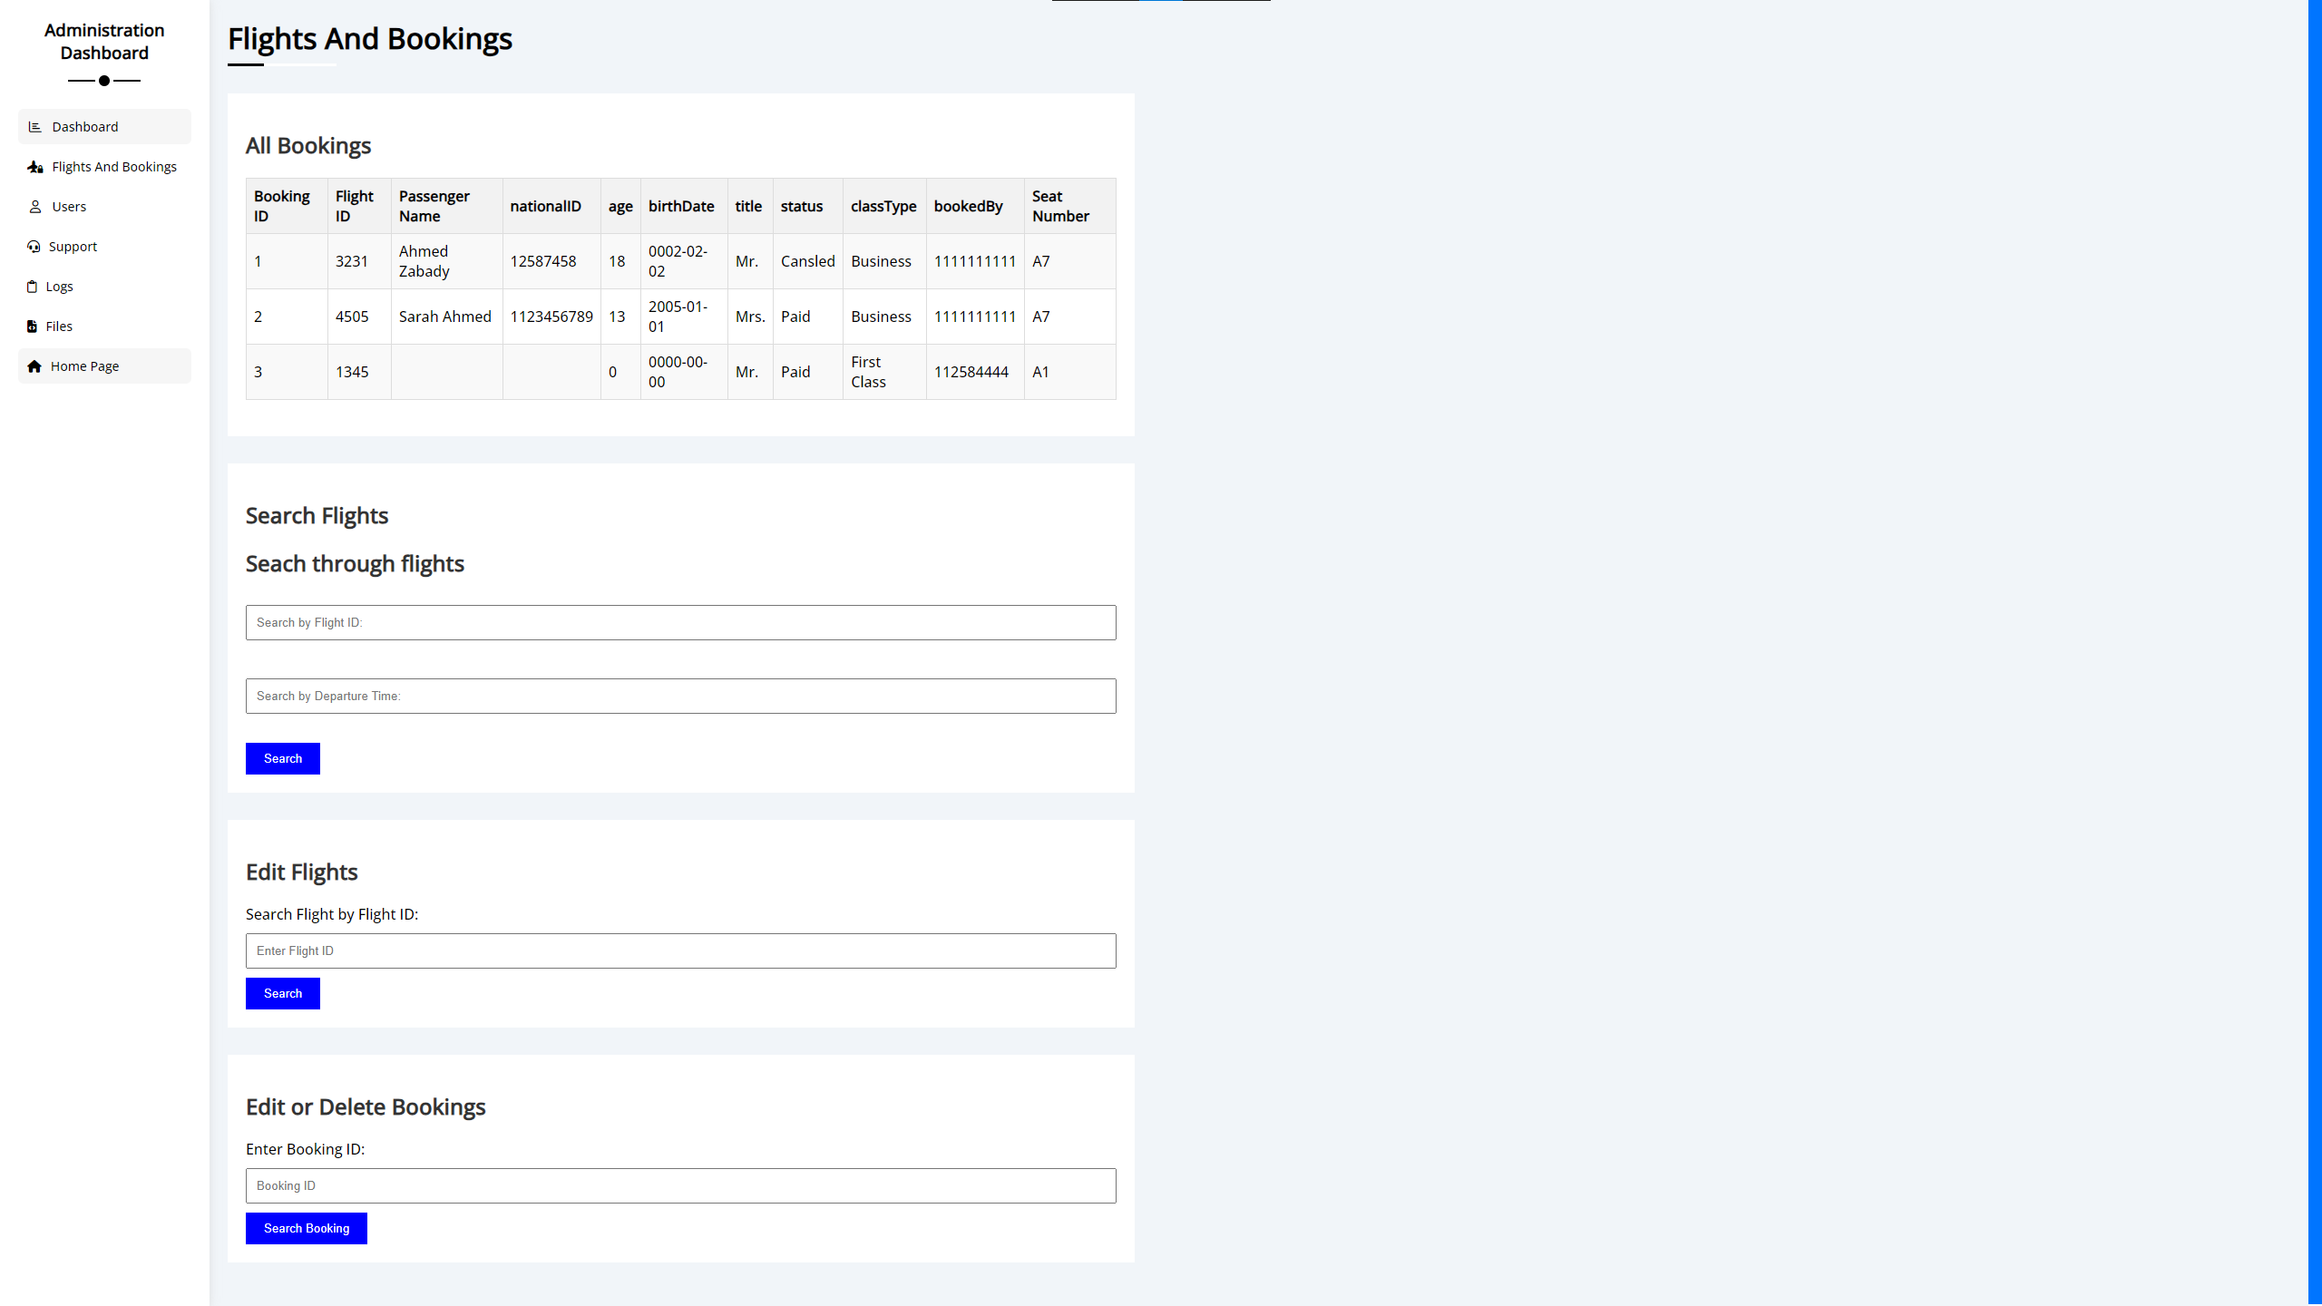
02
Flight-Bookings DB

Slide 48
The Flight and Bookings Section

Slide 49
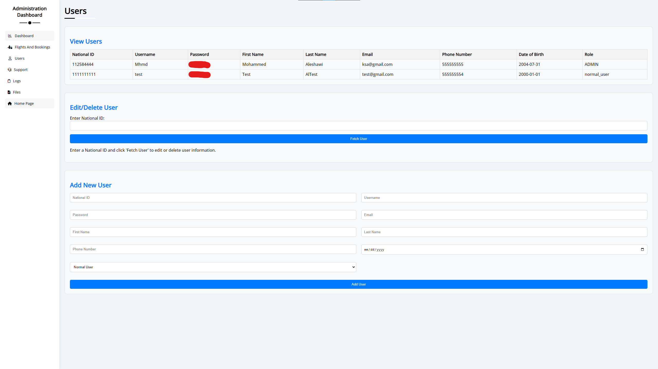
03
Users DB

Slide 50
The Users Section

Slide 51
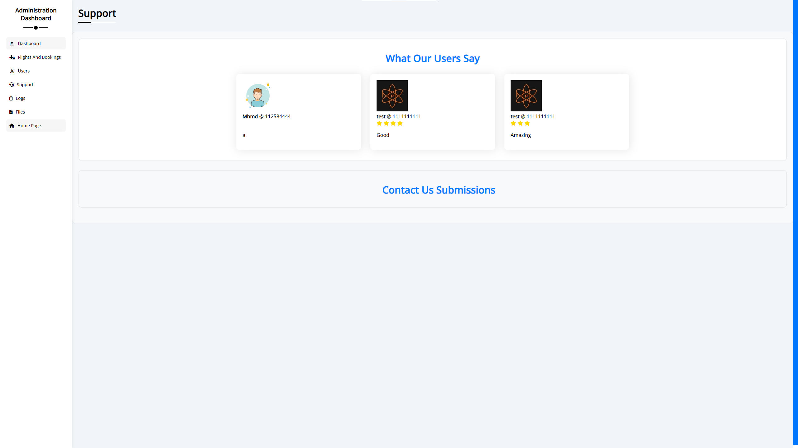
04
Support DB

Slide 52
The Supoort Section

Slide 53
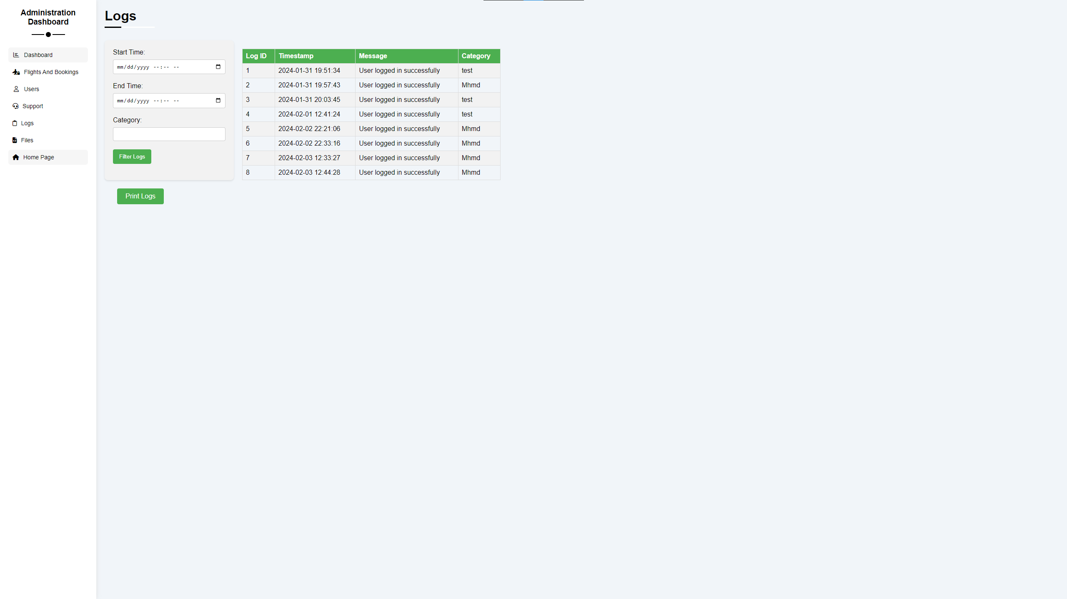
05
Logs DB

Slide 54
The Home Section

Slide 55
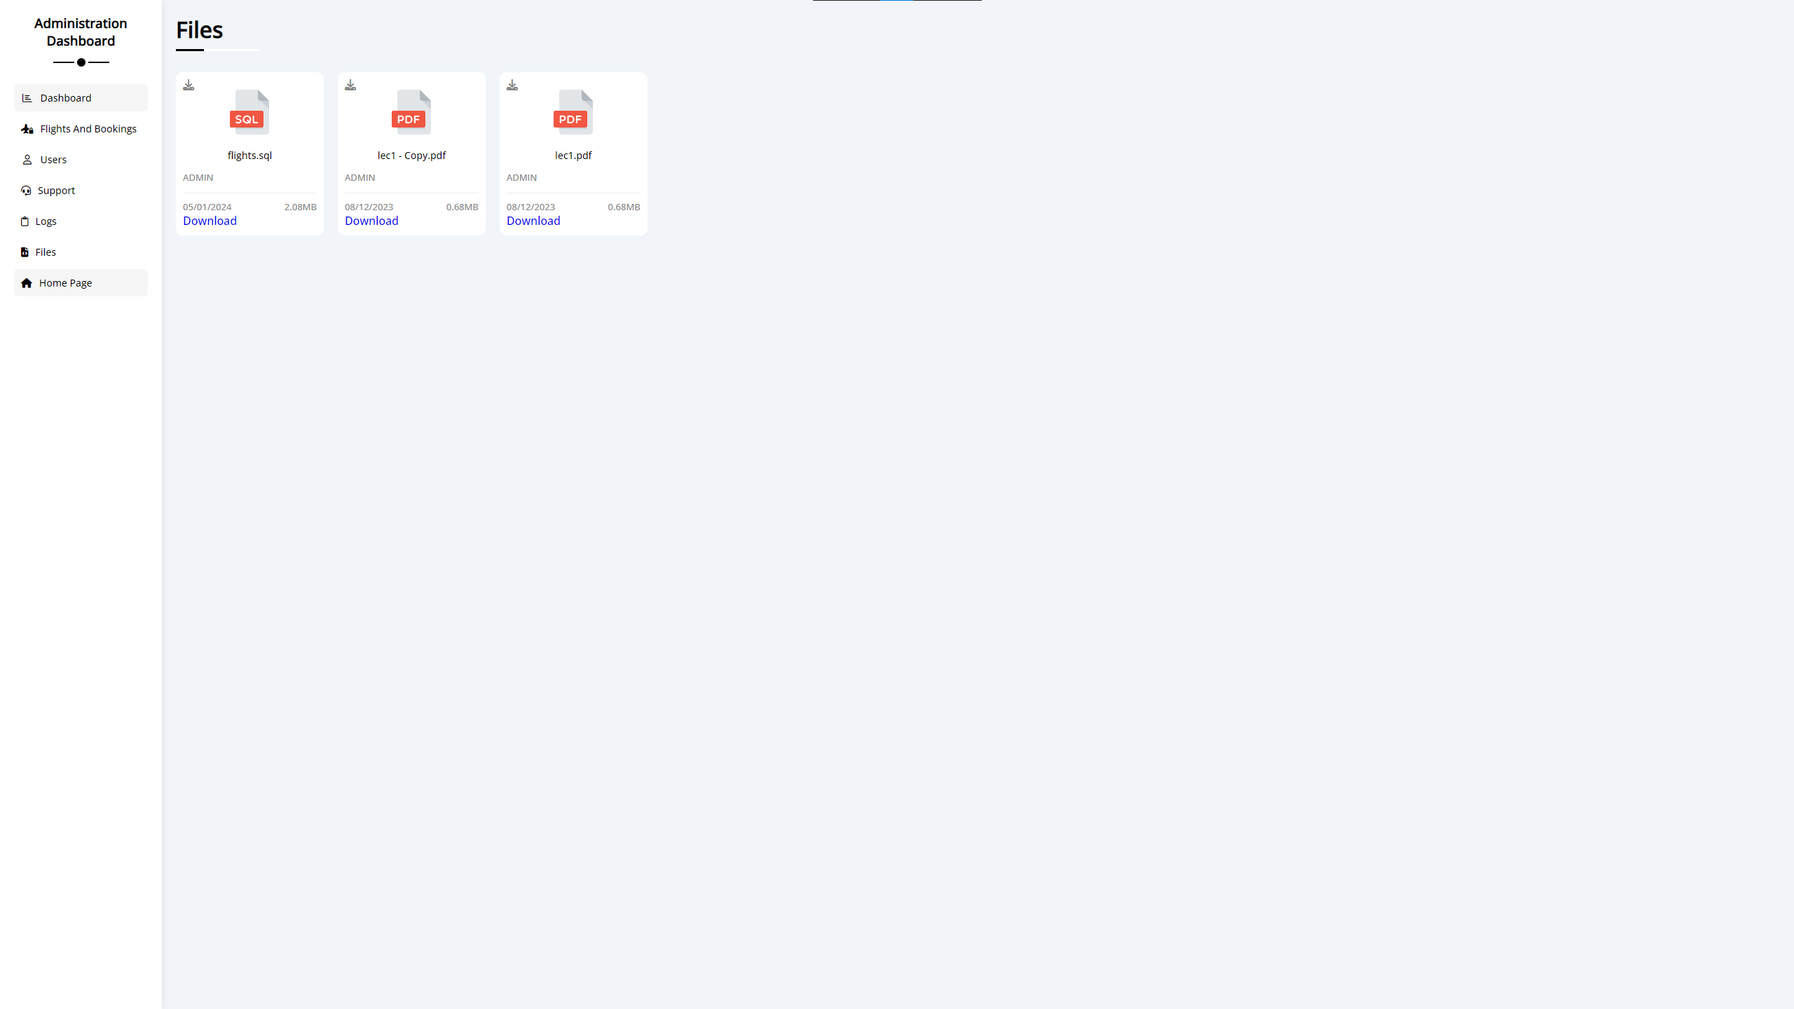
06
Files DB

Slide 56
The Files Section

Slide 57
Summary Of What We Did In This Presentation
Step 1
Step 2
Step 3
Step 4
Introduction
Analysis Phase
Goals And Objectives
The Development Team
Step 5
Step 6
Step 7
Step 8
KUIL
Loop Of Development And Timeline
Software Requirements
User Interface and User Experience
(UI/UX)

Slide 58
Thanks!
Made By Mohammed Aleshawi, design copyrights go to so many people
Do you have any questions?
As a personal request can you please fill in the form for rating me ?

